Slide 1

End-to-End Loan Lifecycle Analysis
Presented By
GULNAAZ ALI
Data Analyst

Slide 2
The Challenge: Navigating Loan Portfolio Risks
Financial institutions face challenges in managing loan portfolios and assessing borrower risk. With large volumes of applicants, it is difficult to analyze demographic details, financial behavior, and past credit performance in one place.
"Scattered datasets and limited visibility into repayment trends make it harder to identify high-risk customers, predict defaults, and optimize loan approvals."
This lack of a holistic view impedes proactive risk mitigation and efficient decision-making, impacting profitability and portfolio quality.

Slide 3
Our Objectives: Driving Data-Driven Loan Decisions
360° Customer View
Credibility Assessment
Repayment Monitoring
Segment loan applications by demographics, income, and loan type for a comprehensive borrower profile.
Evaluate borrower credibility through historical credit records and detailed repayment patterns.
Track installment payments to detect delays, defaults, and repayment consistency.
Early Risk Detection
Optimized Approvals
Identify high-risk customers early by leveraging insights from previous credit and installment behavior.
Empower financial institutions with data-driven insights for efficient, low-risk loan approval decisions.

Slide 4

Comprehensive Data Sources for Analysis
To provide a robust analysis of the loan lifecycle, we integrate data from four critical sources, creating a holistic view of each applicant's financial profile and behavior.
1
2
Application Data
Previous Applications
Includes customer demographics, income, requested credit amount, and a crucial default flag for outcome analysis.
Details on past loan requests, including approval/refusal status, amounts, and decision timelines, highlighting historical engagement.
3
4
Installment Payments
Credit Card Balance
Comprehensive loan repayment history, capturing due dates, actual payment dates, and amounts for behavior tracking.
Monthly credit card usage data, encompassing balance, credit limit, and any recorded delinquency, offering insights into revolving credit habits.

Slide 5
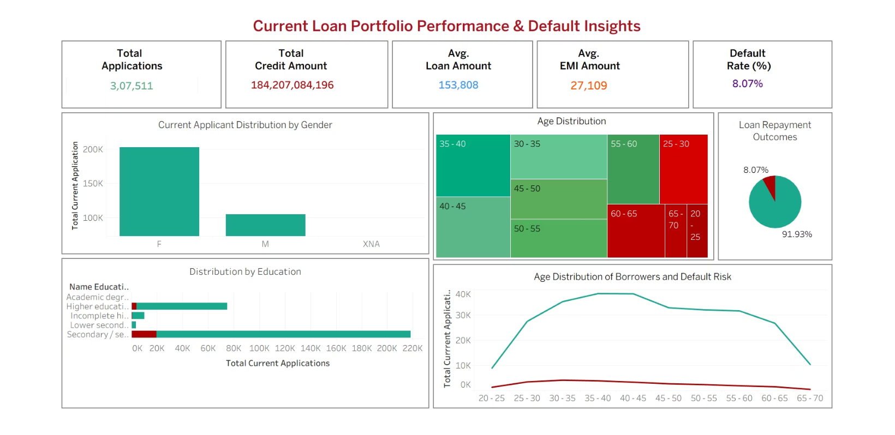
Loan Portfolio Snapshot: Key Demographics & Trends
Scale: Over 3 lakh applications with ₹184 billion in credit exposure.
Average Loan: Approximately ₹1.53 lakh per borrower, with ₹27,000 typical monthly EMI.
Gender Distribution: Female applicants outnumber male borrowers.
Age Demographics: Most borrowers are 30–40; higher defaults among <30 and >60 age groups.
Education: Majority have secondary/senior secondary education; lower education levels show higher defaults.
Repayment Rate: 91.93% repay on time, while 8.07% default.

Slide 6
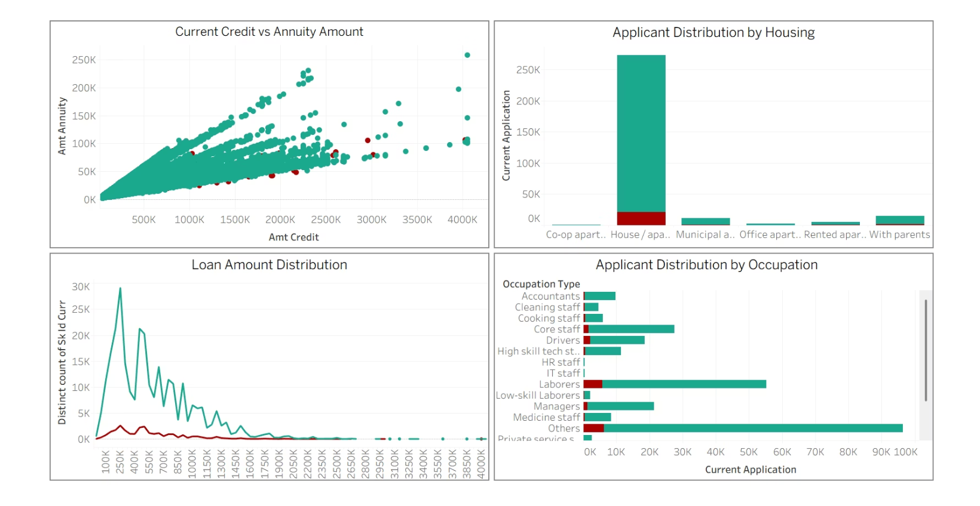
Borrower Profiles & Default Hotspots
Annuity & Loan Size: Larger loans correspond to higher annuity payments; monitor unusually high cases.
Housing Status: Most applicants reside in houses/apartments, followed by those living with parents. Very few live in rented or municipal housing.
Loan Amount vs. Default: Most loans fall within the ₹100K–₹500K range, which also sees common defaults.
Occupation Risk: Laborers, core staff, and "others" constitute the majority of applicants, with higher default risks. Managers and IT staff, though fewer, exhibit lower default rates.

Slide 7
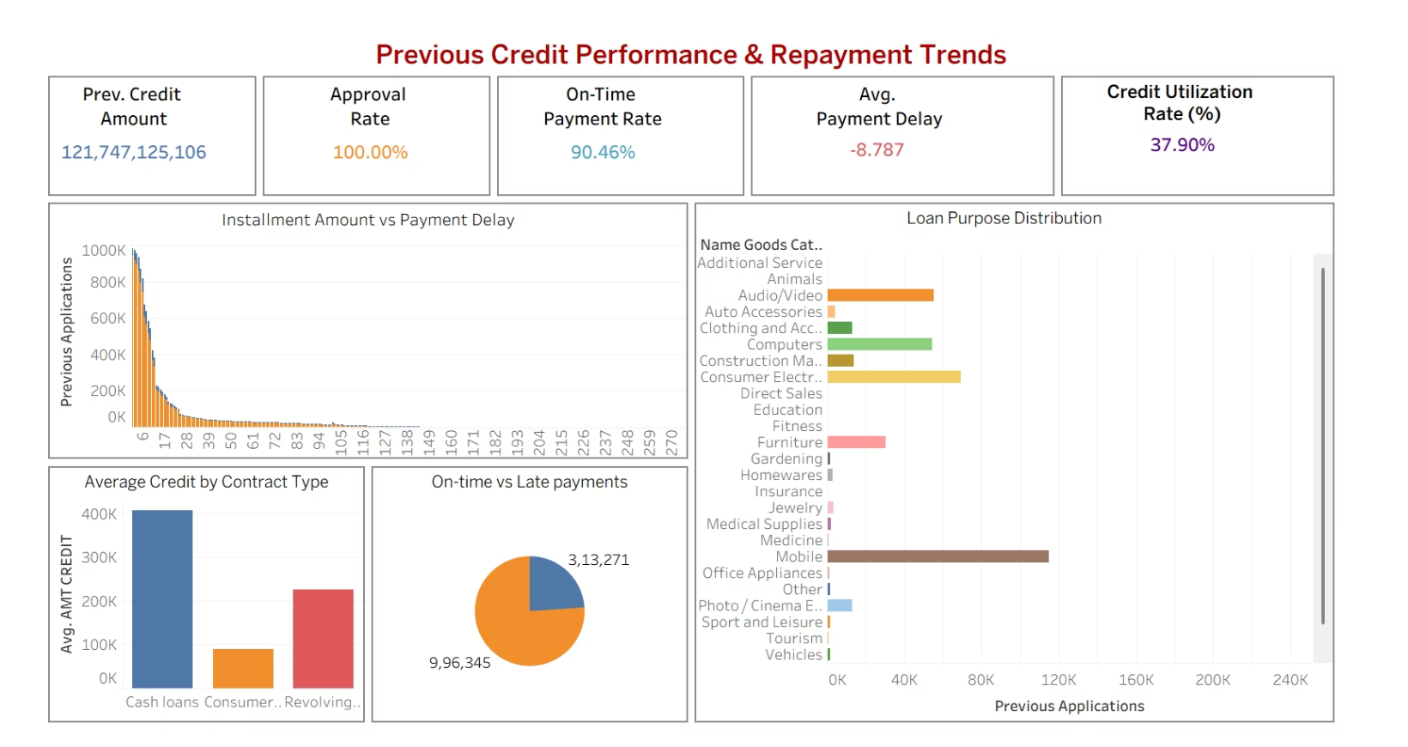
Previous Credit Behavior & Repayment Dynamics
Previous Credit Performance: ₹121 billion in previous credit with a 100% approval rate.
Repayment Efficiency: 90.46% payments were on time, with an average early repayment trend of –8.78 days.
Credit Utilization: Current utilization stands at 37.9%, indicating significant unused capacity.
Repayment Timing: Most repayments occur in the first few months, though some delays are observed.
Loan Purpose Risks: High defaults in Mobile and consumer durable categories.
Loan Type Trends: Cash loans have the highest average credit (~₹400K); consumer and revolving credits are smaller but significant.
Late Payments: While 90% repay on time, a small share of late repayments contributes to overall risk.

Slide 8
Strategic Recommendations for Risk Mitigation
Targeted Risk Assessment
Strengthen scrutiny for borrowers <30 or >60 years old due to elevated default risks.
Education-Based Interventions
Implement financial literacy programs or tighter checks for applicants with lower education levels.
Occupation-Aligned Strategy
Apply stricter credit checks for laborers and low-skill workers; offer favorable terms to stable job categories (e.g., managers, IT staff).
Loan Size Monitoring
Maintain close oversight on loans in the ₹100K–₹500K range, where defaults are concentrated.
Product Risk Control
Reassess risk pricing for loans tied to Mobile, furniture and consumer durables due to higher default rates.
Incentivize Timely Payments
Offer incentives like lower interest or cashback for early or on-time repayments to reinforce positive behavior.
Outlier Monitoring
Investigate borrowers with high annuity-to-credit ratios for potential over-leveraging risks.
Optimize Credit Utilization
Leverage 37.9% utilization to cross-sell additional products to trustworthy borrowers, expanding revenue without excessive risk.

Slide 9












Tangible Business Impact & Future Growth
Enhanced Risk Management
Increased Profitability
Precise identification of high-risk groups leads to reduced defaults and a stronger, more resilient portfolio.
Targeting reliable borrower segments improves loan recovery rates and directly boosts the institution's bottom line.
Optimized Product Strategy
Customer Retention & Growth
Insights into loan purpose defaults enable smarter re-pricing and product redesign, minimizing potential losses.
High on-time repayment rates provide significant opportunities to upsell and cross-sell to a trusted customer base, driving revenue.
Improved Operational Efficiency
Portfolio Stability
Focused monitoring of repayment patterns supports faster, more informed decisions, reducing the cost of risk management.
Balancing stricter checks for risky segments with incentives for timely payers ensures sustainable growth and stability.

Slide 10

Thank You

